Slide 1

A Case Study in Talent Management
By Ben Goodwin

Slide 2
Project Deliverables
What are the primary drivers of attrition?
Identification of job role specific trends
Model for predicting attrition
Model for salary prediction

Slide 3
QOI: What factors lead to attrition?
Data contains 38 variables concerning employee retention
Heavily skewed towards non-attrition (140 vs 730)
Attrition has many root causes, identifying three variables from data that “most contribute” may not paint the whole picture
Proposed Solution: Principal Component Analysis
Idea: Use linear algebra to project all 38 variables onto a higher dimensional plane, rotate them with the goal of dimension reduction
More plainly: Take the dataset, perform some calculations to rearrange the variables as linear combinations of one another called principal components
Attrition dataset is left with 15 PC’s that account for 81% of total variation in data
We are left with fewer, yet more robust variables which give insight into attrition.
The three PC’s which account for the most variation in the data will be analyzed as attrition factors

Slide 4
Attrition Factors
Approach to selecting attrition factors
Use PCA to reduce dimensions of attrition data
27 of the original variables selected
Salary information reduced (monthly income kept)
Non-varying variables eliminated (work week hours and over18)
PCA reduced data to 15 components capturing 81% of variation
Three PC’s selected based on their relationship to attrition
Each PC is a linear combination of original 27 variables now contained in PC

Slide 5
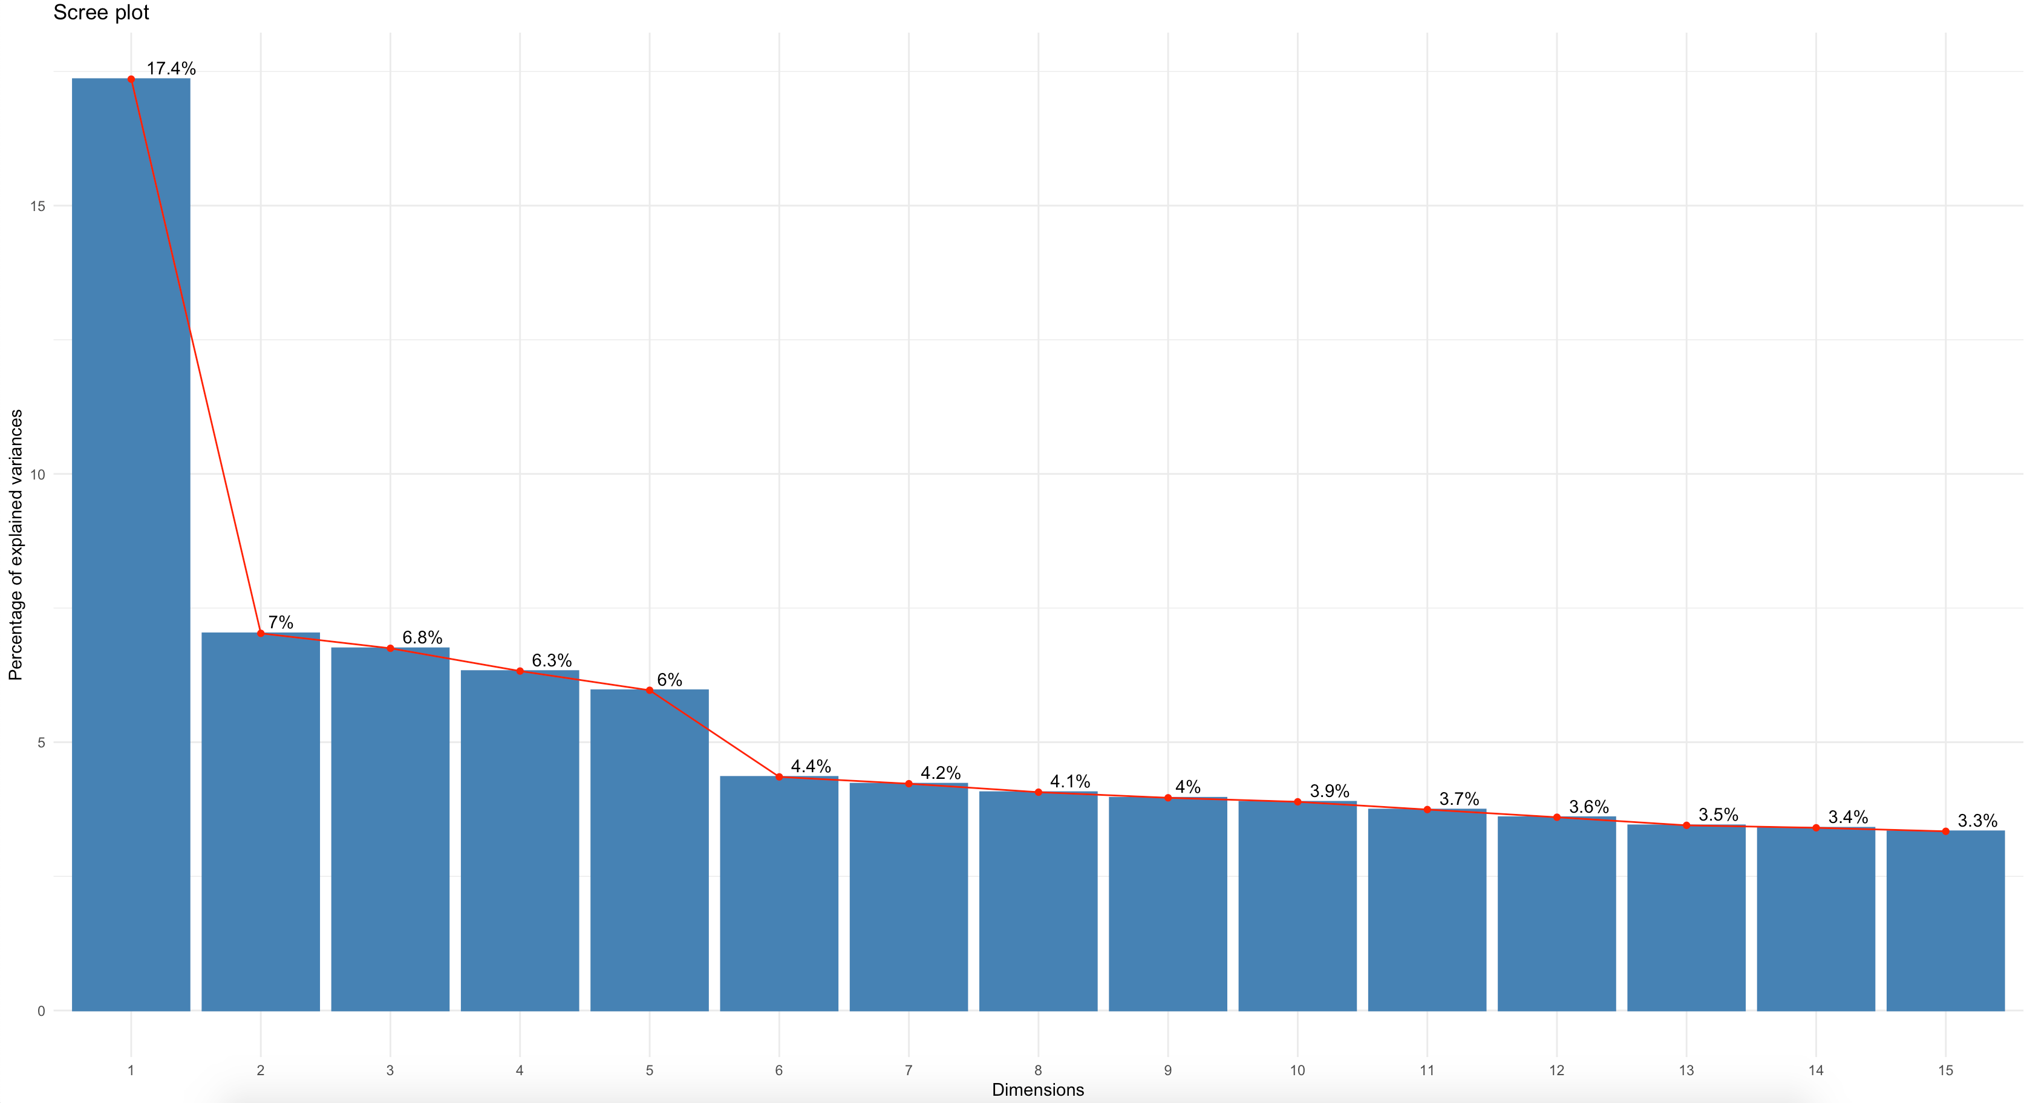
Attrition Factors Component Selection

Slide 6
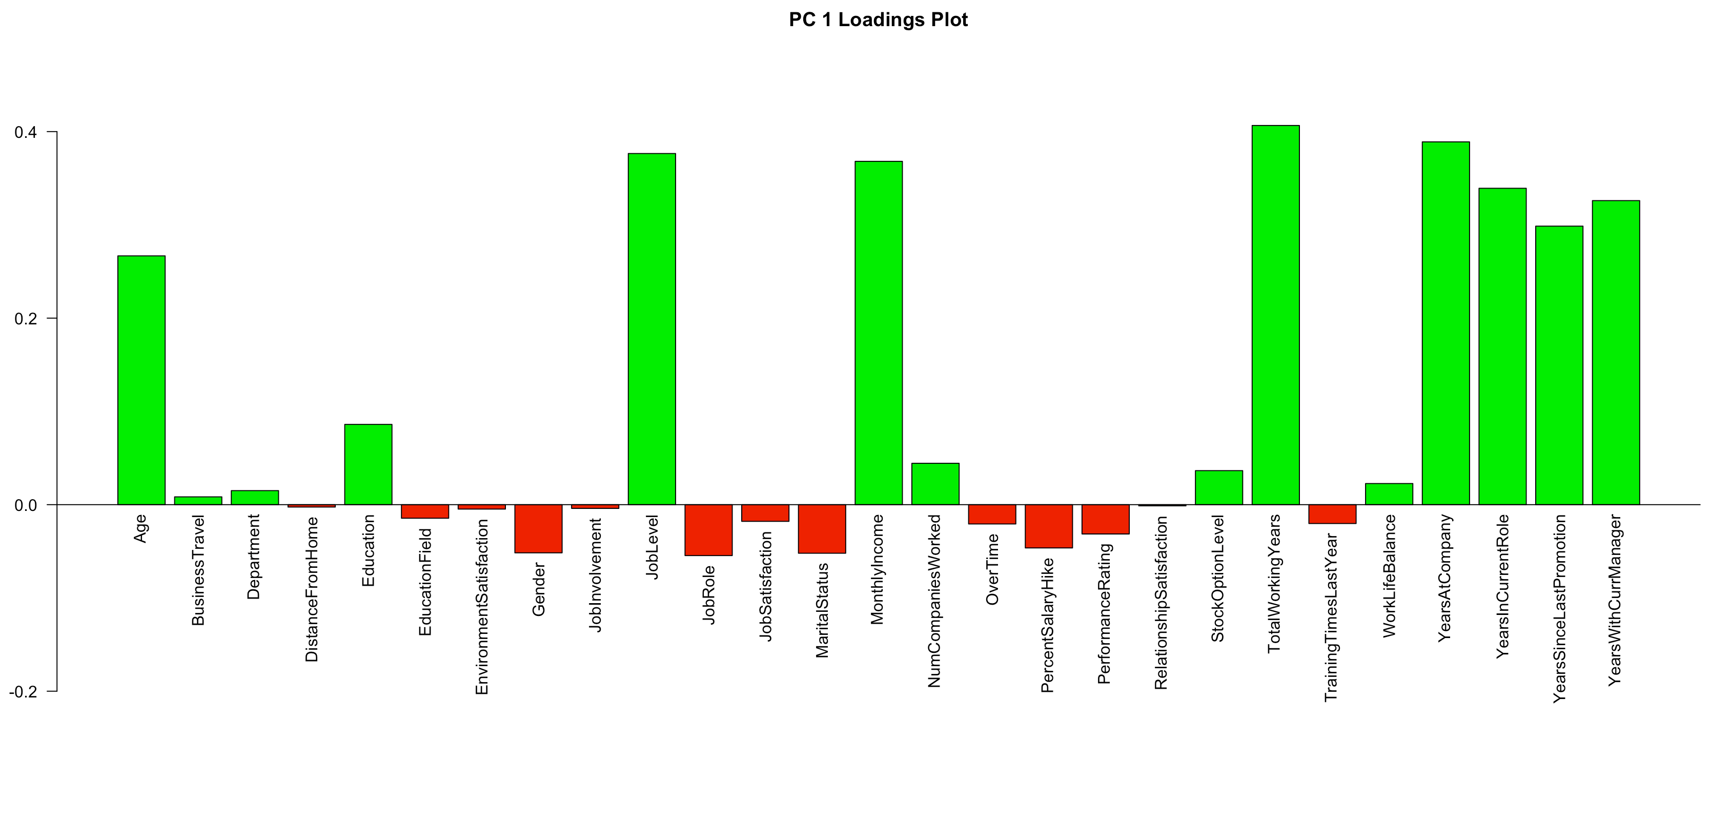
Component 1 Loadings
Key Loadings for PC1
Total working years
Years at company
Job level
Monthly income
The first component is positively correlated with total working years, years at company, job level, monthly income. This suggests the give variables vary together and when one goes down, the others decrease as well. The component could be considered a primary measure of career length and longevity and well as a measure of success.

Slide 7
Key Takeaways

Slide 8
YouTube Link

